Slide 1
VISUAL PROGRAMMING CSC444/CSC412

Slide 2
Topics to Cover
What is ADO.NET
Data Providers
Connection Object
Connection Strings
Command in ADO.NET
Data Reader Object

Slide 3
What is ADO.NET
ADO stands for Microsoft ActiveX Data Objects.
ADO.NET is not a different technology. In simple terms, you can think of ADO.NET, as a set of classes (Framework), that can be used to interact with data sources like Databases and XML files.
This data can, then be consumed in any .NET application. (Desktop, Web etc)

Slide 4
ADO.NET
The following are, a few of the different types of .NET applications. that use ADO.NET to connect to a database, execute commands, and retrieve data.
ASP.NET Web Applications
Windows Applications
Console Applications

Slide 5
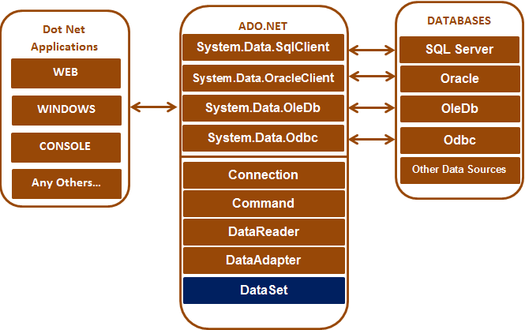
ADO.NET

Slide 6
Dot Net Data Providers
Data Provided for SQLServer
System.Data.SqlClient
Data Provided for Oracle
System.Data.OracleClient
Data Provided for OLEDB( an API designed by Microsoft, allows accessing data from a variety of sources in a uniform manner.)
System.Data.OleDb
Data Provided for ODBC(an open standard Application Programming Interface (API) for accessing a database primarily to sql in multi platform environment)
System.Data.Odbc

Slide 7
OLE DB (Object Linking and Embedding, Database, sometimes written as OLEDB or OLE-DB), an API designed by MS, allows accessing data from a variety of sources in a uniform manner.
ODBC (Open Database Connectivity )is a standard (API) for accessing (DBMS). The designers of ODBC aimed to make it independent of database systems and OS. An application written using ODBC can be ported to other platforms, both on the client and server side, with few changes to the data access code.

Slide 8
ODBC: Originally designed for relational databases. (since changed)
On-going support for SQL
More difficult to deploy
OLEDB: Originally designed for non-relational and relational databases.
SQL support void 2019
Easier to deploy

Slide 9
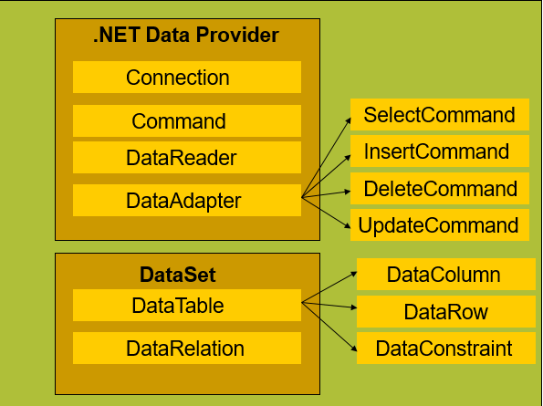
ADO.net Architecture

Slide 10
Microsoft SQL Server
Microsoft SQL Server is a relational database management system developed by Microsoft.
As a database server, it is a software product with the primary function of storing and retrieving data as requested by other software applications—which may run either on the same computer or on another computer across a network (including the Internet).

Slide 11
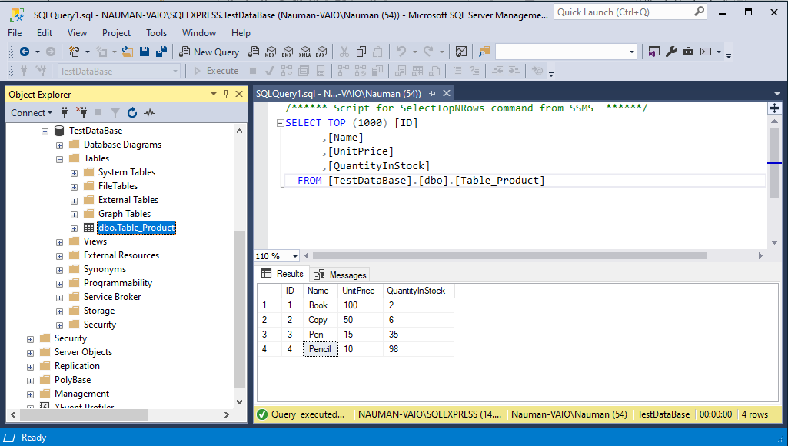
Microsoft SQL Server

Slide 12
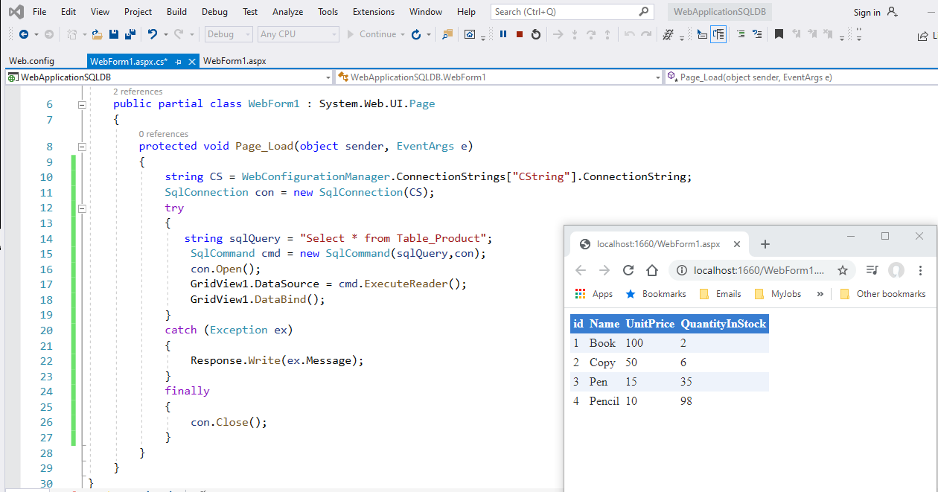
Dot Net Data Providers

Slide 13
The Grid View control displays the values of a data source in a table. Each column represents a field, while each row represents a record. The GridView control supports the following features:
Binding to data source controls, such as SqlDataSource.
Built-in sort capabilities.
Built-in update and delete capabilities.
Built-in paging capabilities.
Built-in row selection capabilities.
Multiple key fields.
Multiple data fields for the hyperlink columns.
Customizable appearance through themes and styles.

Slide 14
Connection
Connections should be opened as late as possible, and should be closed as early as possible.
Connections should be closed in the finally block, or using, the USING statement.
SqlConnection
SqlConnection conn=new SqlConnection();
Conn.ConnectionString=“User ID=sa;password=; Data Source=MyServer;Initial Catalog=Northwind;”
ConnectionString Parameters
Provider
Data Source
Initial Catalog
Integrated Security
UserID/Password

Slide 15
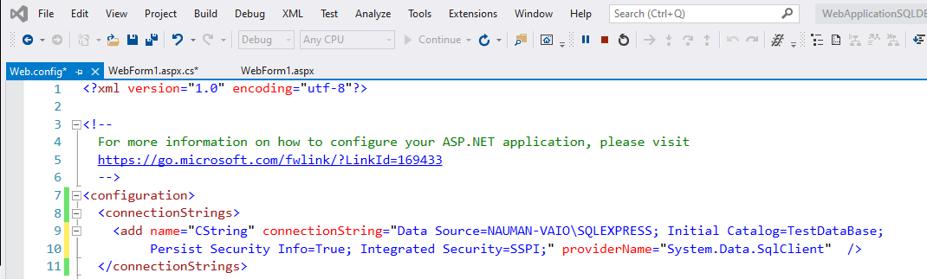
SQL Connection
ConnectionStrings in web.config configuration file (Web Applications)

Slide 16
Integrated and Persist Security
Integrated Security is the type of user authentication. True corresponds to “Windows Authentication”, and False corresponds to “SQL Server Authentication”; User ID is the login for accessing SQL Server (see step 4); Password is the password for accessing SQL Server.
The Persist Security Info string specifies whether the connection persists (caches) the password information used while connecting, and should not be modified.

Slide 17
Command Object
A command object is a reference to a SQL statement or stored procedure
SqlCommand class is used to prepare an SQL statement or Stored Procedure that we want to execute on a SQL Server database.
Properties
Connection
CommandType
CommandText
Parameters

Slide 18
Command Methods
The most commonly used methods of the SqlCommand class
1. ExecuteReader- Use when the SQL statement returns more than a single value. For example, if the query returns rows of data.
2. ExecuteNonQuery- Use when you want to perform an Insert, Update or Delete operation.
3. ExecuteScalar- Use when the query returns a single(scalar)value. For example, queries that return the total number of rows in a table.

Slide 19
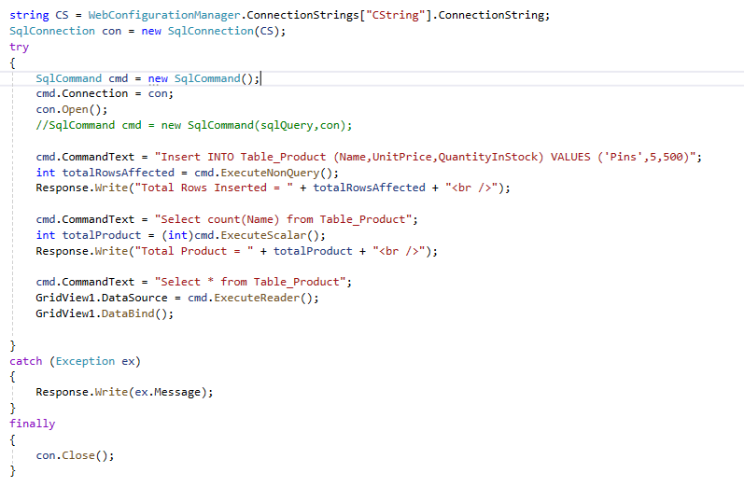
SqlCommand

Slide 20
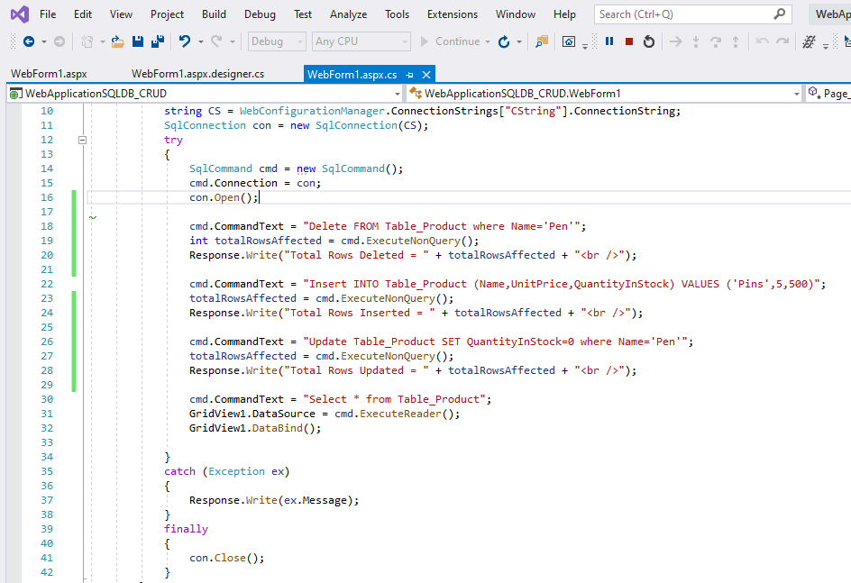
CRUD operations in SQL using C#

Slide 21
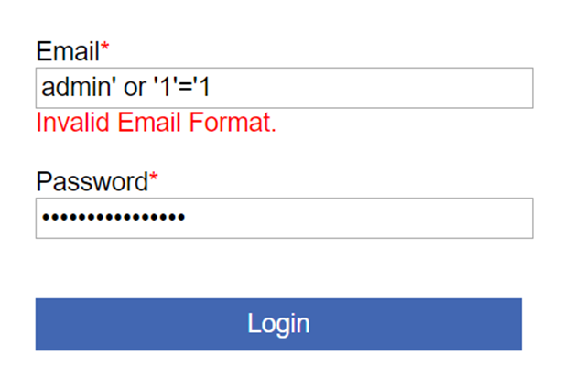
SQL injection
SQL injection is a code injection technique that might destroy your database.
SQL injection is one of the most common web hacking techniques.
SQL injection is the placement of malicious code in SQL statements, via web page input.

Slide 22
Connected Environment (Scenario)
1. Open connection
2. Execute command
3. Process rows in reader
4. Close reader
5. Close connection

Slide 23
Connected Environment
Working with data directly via open connection
Advantages
Simple security realization
Work with real data
Simple organization of distributed work
Drawbacks
Continual connection

Slide 24
Disconnected Environment (Scenario)
1. Open connection
2. Fill the DataSet
3. Close connection
4. Process the DataSet
5. Open connection
6. Update the data source
7. Close connection

Slide 25
Disconnected Environment
Storage of data local copy from repository
Possibility to update the main data source
Advantages
Economy of server resources
Does not require continual connection
Drawbacks
Demands conflict resolution while data update
Data is not always up to date

Slide 26
DataReader Object
Similar to other ADO.NET objects, each data provider has a data reader class for example;
OleDbDataReader is the data reader class for OleDb data providers
SqlDataReader for SQL database
ODBC DataReader are data reader classes ODBC data providers
By calling the ExecuteReader method of the Command object, it returns an instance of the DataReader. For example, use the following line of code:
SqlCommand cmd = new SqlCommand(SQL, conn);
// Call ExecuteReader to return a DataReader
SqlDataReader reader = cmd.ExecuteReader();
Once you're done with the data reader, call the Close method to close a data reader:
reader.Close();

Slide 27
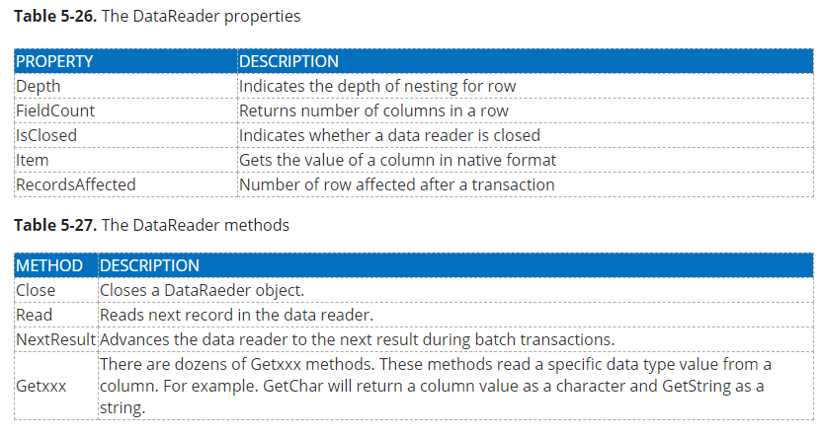
DataReader Properties and Methods
Notes:
This will be a graphics slide.

Slide 28
// Create a command object
SqlCommand cmd = new SqlCommand(SQL, conn);
conn.Open();
// Call ExecuteReader to return a DataReader
SqlDataReader reader = cmd.ExecuteReader();
Console.WriteLine("customer ID, Contact Name, " + "Contact Title, Address ");
while (reader.Read())
{
Console.Write(reader["CustomerID"].ToString() + ", ");
Console.Write(reader["ContactName"].ToString() + ", ");
Console.Write(reader["ContactTitle"].ToString() + ", ");
Console.WriteLine(reader["Address"].ToString() + ", ");
}
//Release resources
reader.Close();
conn.Close();

